Slide 1


CSE-214
Drawing & Data Visualization
Submitted By -
Saad Al Mahmud
ID - 23701045

Slide 2
1
USEFULNESS
2
PLOT
CONTENTS
3
SOURCE CODE
4
DATASET

Slide 3

Understanding Data
Too Much Data
Making Decisions
Misleading Information
Data
Visualization
Storytelling
Time Consuming
and Risk of Error
Analyzing Pattern

Slide 4
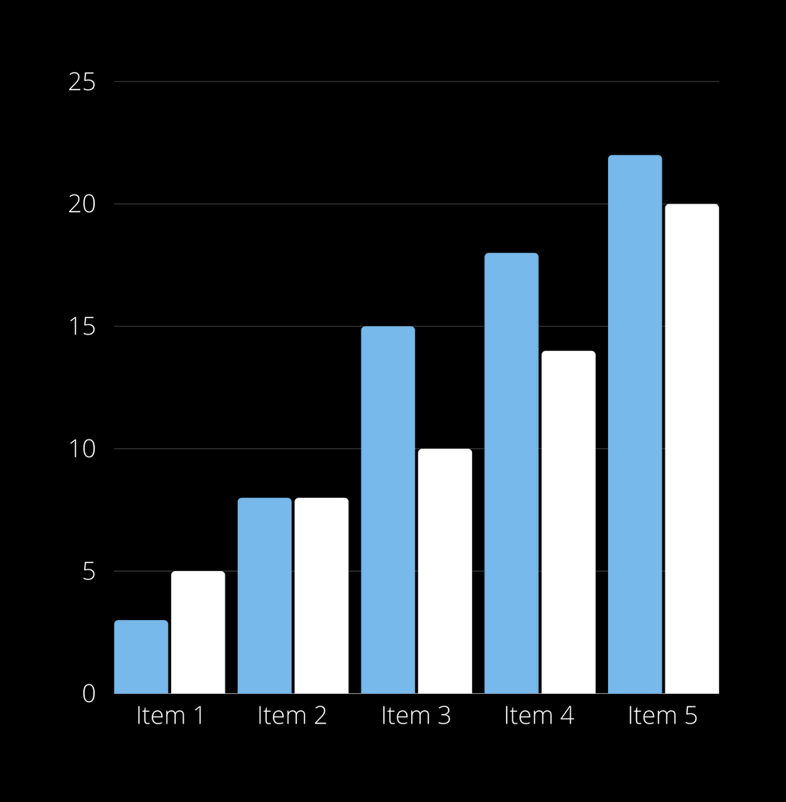



REPORT FROM
LAST YEAR
DATA ONE
Presentations are communication tools that can be used as demonstrations.
DATA TWO
Presentations are communication tools that can be used as demonstrations.

Slide 5


CHART SLIDE
REPORT
DATA ONE
+300K
Presentations are communication tools that can be used as demonstrations.
DATA TWO
Presentations are communication tools that can be used as demonstrations.
DATA TWO
Presentations are communication tools that can be used as demonstrations.

Slide 6
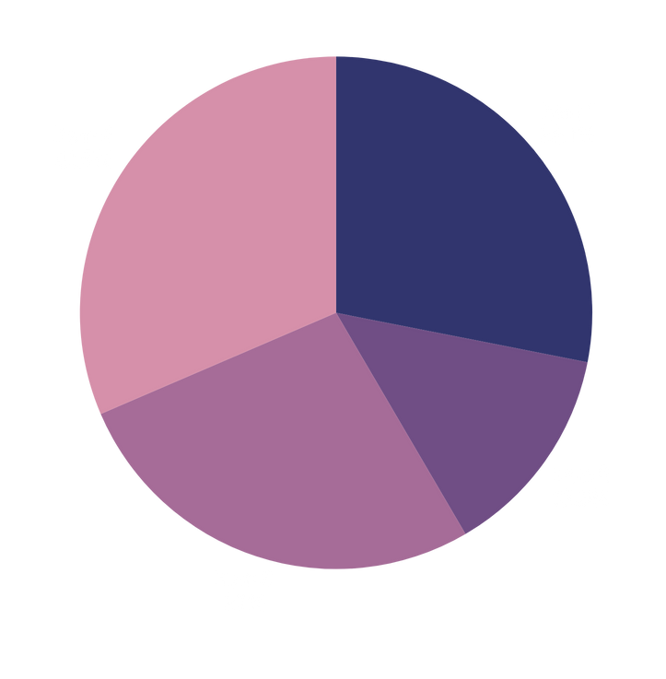
CHART SLIDE REPORT
DATA ONE
DATA TWO
Presentations are communication tools that can be used as demonstrations.
Presentations are communication tools that can be used as demonstrations.
+15%
-8%
DATA FOUR
DATA THREE
Presentations are communication tools that can be used as demonstrations.
Presentations are communication tools that can be used as demonstrations.
-10%
+12%

Slide 7
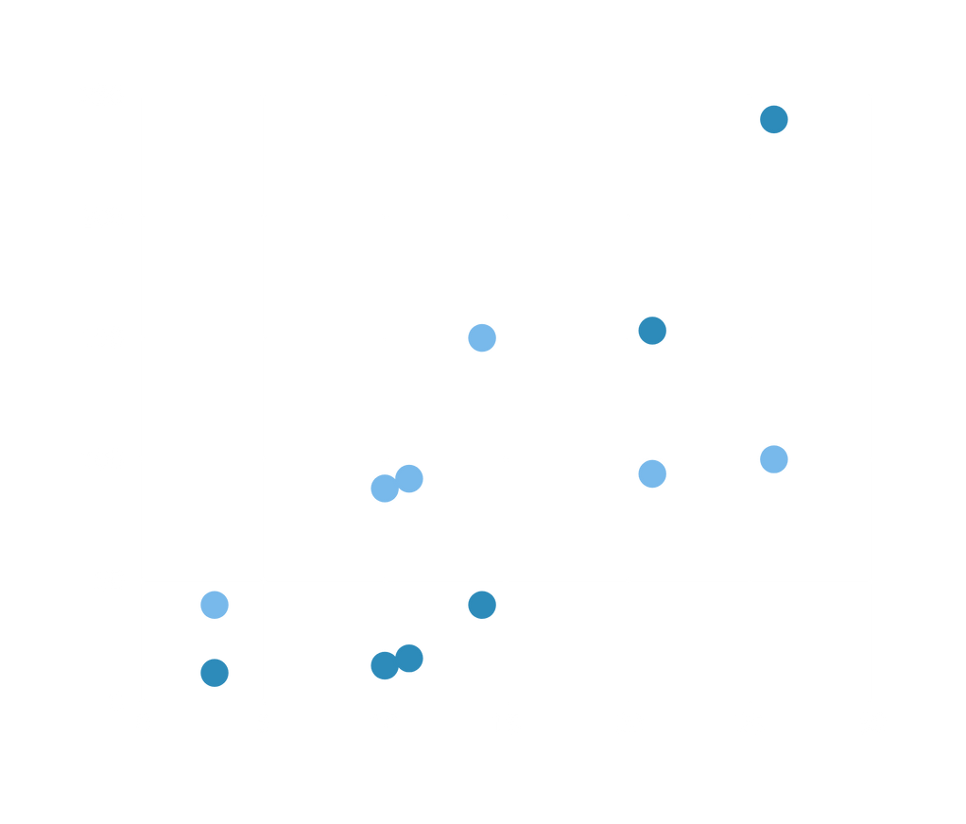


CHART SLIDE
REPORT
DATA ONE
Presentations are communication tools that can be used as demonstrations.
Presentations are communication tools that can be used as demonstrations, lectures, speeches, reports, and more.

Slide 8
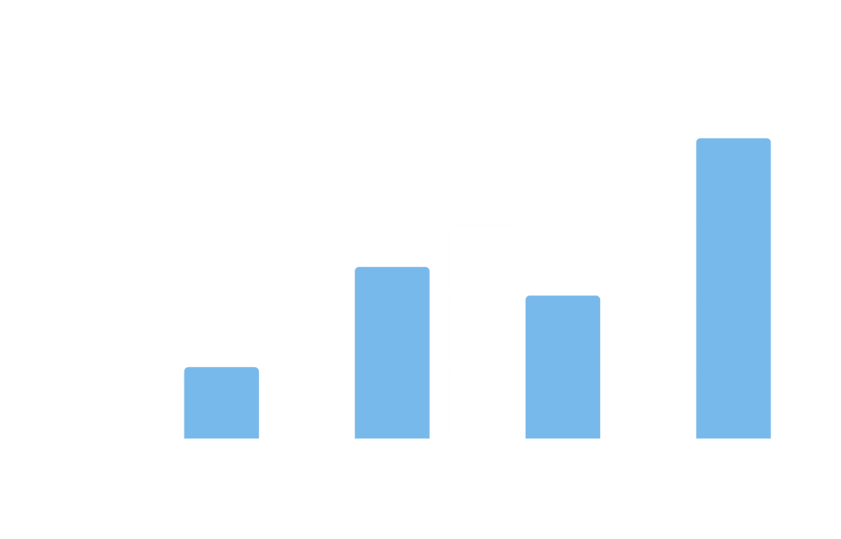


CHART SLIDE
REPORT
CHART DESCRIPTION
Presentations are communication tools that can be used as demonstrations.

Slide 9
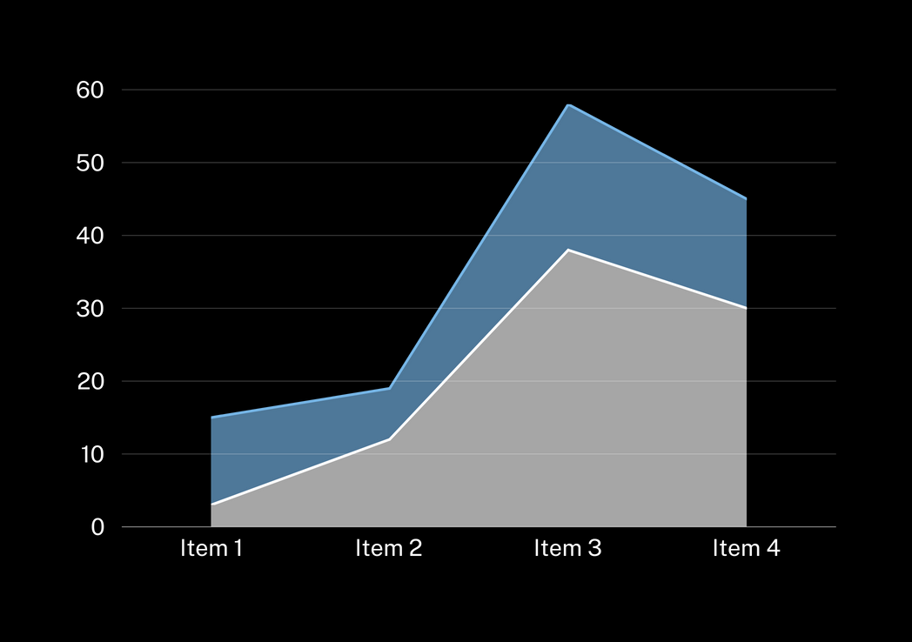



CHART SLIDE
REPORT
ASPECT ONE
Presentations are communication tools that can be used as demonstrations.
ASPECT TWO
Presentations are communication tools that can be used as demonstrations.
ASPECT THREE
DATA ONE
Presentations are communication tools that can be used as demonstrations.
+300K
Presentations are communication tools that can be used as demonstrations.

Slide 10




USERS ONE
USERS TWO
WORLD MAP
CHART SLIDE
Presentations are communication tools that can be used as demonstrations.
Presentations are communication tools that can be used as demonstrations.
DATA ONE
+300K
Presentations are communication tools that can be used as demonstrations.

Slide 11





CHART SLIDE REPORT
MISSION DESCRIPTION
CLIENT DESCRIPTION
Presentations are communication tools that can be used as demonstrations, lectures, speeches, reports, and more.
Presentations are communication tools that can be used as demonstrations, lectures, speeches, reports, and more.
EVERY
ASPECT
STARTUP DESCRIPTION
VISION DESCRIPTION
Presentations are communication tools that can be used as demonstrations, lectures, speeches, reports, and more.
Presentations are communication tools that can be used as demonstrations, lectures, speeches, reports, and more.

Slide 12




INFOGRAPHIC
SLIDE REPORT
SHARING
SHARING
500K
Presentations are communication tools that can be used as demonstrations.
MARKET
40K
Presentations are communication tools that can be used as demonstrations.
BROADCAST
MARKET
BROADCAST
250K
Presentations are communication tools that can be used as demonstrations.

Slide 13




INFOGRAPHIC SLIDE REPORT
SUPERVISOR APPROVMENT
Presentations are communication tools that can be used as demonstrations.
STEP ONE
REPORT PROPOSAL
Presentations are communication tools that can be used as demonstrations.
STEP TWO
DATA ANALYST
Presentations are communication tools that can be used as demonstrations.
STEP THREE

Slide 14






INFOGRAPHIC SLIDE REPORT
DATA ONE
Presentations are communication tools that can be used as demonstrations.
SERVICE ONE
SERVICE TWO
SERVICE ONE
SERVICE TWO
Presentations are communication tools that can be used as demonstrations.
Presentations are communication tools that can be used as demonstrations.
SERVICE THREE
SERVICE FOUR
SERVICE THREE
SERVICE FOUR
Presentations are communication tools that can be used as demonstrations.
Presentations are communication tools that can be used as demonstrations.

Slide 15

Company Name
01-01-2022
THANKS FOR WATCHING
Presentations are communication tools that can be used as demonstrations, lectures, speeches, reports, and more.

